Slide 1
AN ATTRIBUTE-ASSISTED RERANKING MODEL FOR WEB IMAGE SEARCH

Slide 2
INTRODUCTION
Dramatic increase of online images, image retrieval has attracted significant attention in both academia and industry .Many image search engines such as Google and Bing have relied on matching textual information of the images against queries given by users. However, text-based image retrieval suffers from essential difficulties that are caused mainly by the incapability of the associated text to appropriately describe the image content. Recently, visual reranking has been proposed to refine text-based search results by exploiting the visual information contained in the images. The existing visual reranking methods can be typically categorized into three categories as the clustering based, classification based and graph based methods. The clustering based reranking methods stem from the key observation that a wealth of visual characteristics can be shared by relevant images. With intelligent clustering algorithms initial search results from text-based retrieval can be grouped by visual closeness. However, for queries that return highly diverse results or without clear visual patterns, the performance of the clustering-based methods is not guaranteed. In the classification based methods, visual reranking is formulated as binary classification problem aiming to identify whether each search result is relevant or not.

Slide 3
SCOPE OF THE PROJECT:
The Scope of the project is online image re-ranking which limits users effort to just one-click feedback, is an effective way to improve search results and its interaction is simple enough. Major web image search engines have adopted this strategy. To achieve high efficiency, the visual feature vectors need to be short and their matching needs to be fast. The semantic signatures are very short and online image re-ranking becomes extremely efficient.

Slide 4
LITERATURE SURVEY
Title : Multimedia search reranking: A literature survey
Author : T. Mei, Y. Rui, S. Li, and Q. Tian
Year : 2014
Description : The proliferation of capture devices and the explosive growth of online social media have led to the countless private image and video collections on local computing devices such as personal computers, cell phones, and personal digital assistants, as well as the huge yet increasing public media collections on the Internet. For example, the most popular photo sharing site—Flickr, reached five billion photos uploads in 2011, as well as 3-5 million new photos uploaded daily [Kennedy et al. 2007]. Facebook held more than 60 billion photos shared by its communities as of 2011 Facebook, while YouTube streams more than one billion videos per day worldwide [YouTube]. Such explosive growth and widespread accessibility of visual content have led to a surge of research activity in visual search. The key problem is retrieving visual documents (such as images, video clips, and Web pages containing images or videos) that are relevant to a given query or user search intention from a large-scale database.

Slide 5
Title : Igroup: Web image search results clustering
Author : F. Jing, C. Wang, Y. Yao, K. Deng, L. Zhang, and W.-Y. Ma
Year : 2006
Description : IGroup, an efficient and effective algorithm that organizes Web image search results into clusters. IGroup is different from all existing Web image search results clustering algorithms that only cluster the top few images using visual or textual features. Our proposed algorithm first identifies several query-related semantic clusters based on a key phrases extraction algorithm originally proposed for clustering general Web search results. Then, all the resulting images are separated and assigned to corresponding clusters. As a result, all the resulting images are organized into a clustering structure with semantic level. To make the best use of the clustering results, a new user interface (UI) is proposed. Different from existing Web image search interfaces, which show only a limited number of suggested query terms or representative image thumbnails of some clusters, the proposed interface displays both representative thumbnails and appropriate titles of semantically coherent image clusters. Comprehensive user studies have been completed to evaluate both the clustering algorithm and the new UI.
.

Slide 6
Title : Relative attributes
Author : D. Parikh and K. Grauman
Year : 2011
Description : Human-nameable visual “attributes” can benefit various recognition tasks. However, existing techniques restrict these properties to categorical labels (for example, a person
is ‘smiling’ or not, a scene is ‘dry’ or not), and thus fail to capture more general semantic relationships. We propose to model relative attributes. Given training data stating how object/scene categories relate according to different attributes, we learn a ranking function per attribute. The learned ranking functions predict the relative strength of each property in novel images. We then build a generative model over the joint space of attribute ranking outputs, and propose a novel form of zero-shot learning in which the supervisor relates the unseen object category to previously seen objects via attributes (for example, ‘bears are furrier than giraffes’). We further show how the proposed relative attributes enable richer textual descriptions for new images, which in practice are more precise for human interpretation. We demonstrate the approach on datasets of faces and natural scenes, and show its clear advantages over traditional binary attribute prediction for these new tasks.

Slide 7
Title : Learning with hypergraphs: Clustering, classification, and embedding
Author : D. Zhou, J. Huang, and B. Schölkopf
Year : 2006
Description : In machine learning problem settings, we generally assume pairwise relationships among the objects of our interest. An object set endowed with pairwise relationships can be naturally illustrated as a graph, in which the vertices represent the objects, and any two vertices that have some kind of relationship are joined together by an edge. The graph can be undirected or directed. It depends on whether the pairwise relationships among objects are symmetric or not. Anite set of points in Euclidean space associated with a kernel matrix is a typical example of undirected graphs. As to directed graphs, a well-known instance is the World Wide Web. A hyperlink can be thought of as a directed edge because given an arbitrary hyperlink we cannot expect that there certainly exists an inverse one, that is, the hyperlink based relationships are asymmetric. However, in many real-world problems, representing a set of complex relational objects as undirected or directed graphs is not complete. For illustrating this point of view, let us consider a problem of grouping a collection of articles into deferent topics. Given an article, assume the only information that we have is who wrote this article.

Slide 8
Title : Weak attributes for large-scale image retrieval
Author : F. X. Yu, R. Ji, M.-H. Tsai, G. Ye, and S.-F. Chang
Year : 2012
Description : Attribute-based query offers an intuitive way of image retrieval, in which users can describe the intended search targets with understandable attributes. In this paper, we develop a general and powerful framework to solve this problem by leveraging a large pool of weak attributes comprised of automatic classifier scores or other mid-level representations that can be easily acquired with little or no human labor. We extend the existing retrieval model of modeling Dependency within query attributes to modeling dependency of query attributes on a large pool of weak attributes, which is more expressive and scalable. To efficiently learn such a large dependency model without over fitting, we further propose a semi-supervised graphical model to map each multi-attribute query to a subset of weak attributes. Through extensive experiments over several attribute benchmarks, we demonstrate consistent and significant performance improvements over the state-of-the-art techniques. In addition, we compile the largest multi-attribute image retrieval dataset to date, including 126 fully labeled query attributes and 6,000 weak attributes of 0.26 million images.

Slide 9
Title : Multimedia search with pseudo relevance feedback
Author : R. Yan, A. Hauptmann, and R. Jin
Year : 2003
Description : We present an algorithm for video retrieval that fuses the decisions of multiple retrieval agents in both text and image modalities. While the normalization and combination of evidence is novel, this paper emphasizes the successful use of negative pseudo-relevance feedback to improve image retrieval performance. Although we have not solved all problems in video information retrieval, the results are encouraging, indicating that pseudo-relevance feedback shows great promise for multimedia retrieval with very varied and errorful data.

Slide 10
Title : Learning to detect unseen object classes by between-class attribute transfer
Author : C. H. Lampert, H. Nickisch, and S. Harmeling
Year : 2009
Description : We study the problem of object classification when training and test classes are disjoint, i.e. no training examples of the target classes are available. This setup has hardly been studied in computer vision research, but it is the rule rather than the exception, because the world contains tens of thousands of different object classes and for only a very few of them image, collections have been formed and annotated with suitable class labels. In this paper, we tackle the problem by introducing attribute-based classification. It performs object detection based on a human-specified high-level description of the target objects instead of training images. The description consists of arbitrary semantic attributes, like shape, color or even geographic information. Because such properties transcend the specific learning task at hand, they can be pre-learned, e.g. from image datasets unrelated to the current task. Afterwards, new classes can be detected based on their attribute representation, without the need for a new training phase. In order to evaluate our method and to facilitate research in this area, we have assembled a new largescale dataset, “Animals with Attributes”, of over 30,000 animal images that match the 50 classes in Osherson’s classic table of how strongly humans associate.

Slide 11
Title : Image retrieval via probabilistic hyper graph ranking
Author : Y. Huang, Q. Liu, S. Zhang, and D. N. Metaxas
Year : 2010
Description : In content-based image retrieval (CBIR) visual information instead of keywords is used to search images in large image databases. Typically in a CBIR system a query image is provided by the user and the closest images are returned according to a decision rule. In order to learn a better representation of the query concept, a lot of CBIR frameworks make use of an online learning technique called relevance feedback users are asked to label images in the returned results as ‘relevant’ and/or ‘not relevant’, and then the search procedure is repeated with
The new information. Previous work on relevance feedback often aims at learning discriminative models to classify the relevant and irrelevant images, such as, RF methods based on support vector machines decision trees boosting Bayesian classifiers and graph-cut. Because the user-labeled images are far from sufficient for supervised learning methods in a CBIR system, recent work in this category attempts to apply transductive or semi-supervised learning to image retrieval. For example, presents an active learning framework, in which a fusion of semi-supervised techniques (based on Gaussian fields and harmonic functions) and SVM are comprised.

Slide 12
PROJECT IMPLEMENTATION
MODULES
Admin
Authentication
Upload File
View images
USER
Authentication
Text based Image search
Attribute Search
Attribute-Augmented
Upload File

Slide 13
MODULE DESCRIPTION & MODULE DIAGRAMS
Authentication:
An Administrator wants to access their page means they have to Login in with providing User id and password. If Administrator’s user id and password are exists means access was granted.
Validate
Sign in
Administrator page
Database

Slide 14
Upload file:
In this scheme data owner upload the image files in the database. Each service has different set of files. Data owner collect several file from the local path and stored in the database. This database has collection of server cluster which uniquely connected with the search engine.
File Upload
Image
Find Server Path
Database

Slide 15
View Report:
Admin textually enter the image name in the search engine. If the query specified text is present inside the index means then that category image will displayed in the browser or else it can match the text with an entire database.
Admin
Search Image
Search Image Result
DB

Slide 16
USER
Authentication:
If you are the new user going to login into the application then you have to register first by providing necessary details. After successful completion of sign up process, the user has to login into the application by providing username and exact password. The user has to provide exact username and password which was provided at the time of registration, if login success means it will take up to main page else it will remain in the login page itself.
No
CHECK
STATUS
LOGIN
Yes
Proceed To next
Page
DB

Slide 17
Text-based Image Search:
Our search engine first searches the pages and then gets the result searching for the metadata to get the trusted results search engines require searching for pages that maintain such information at some place. Here propose the intelligent semantic web based search engine.
Search Engine
User
Search Image
View Result
Database

Slide 18
Attribute Search:
Users want to view the image from search results means they choose a image from result and it will be previewed with Augmented image descriptions. The Preview will not be a normal one; it will be shown with the tree structured with its augmented information.
User
Search with attribute name
View image with attribute
Cloud DB

Slide 19
Upload Image:
After augmenting image description and semantic process an image want to be uploading into database. In this uploading module the Image path will be provide by admin and click the upload button means image will be stored in the particular directory of database.
Admin
Image uploading process
Database
Attribute-Augmented:
In this module, user collects the descriptions of a particular image which want to extend from existing descriptions which adds some more additional information about that image.
User
Collects the augments of image
View Result
Database

Slide 20
GIVEN INPUT AND EXPECTED OUTPUT
ADMIN
Input: Provide User id and password.
Output: Authentication success means they will get access.
IMAGE UPLOAD
Input: Choose the image path.
Output: Image will be uploaded to database successfully
View Files:
Input: User Search Query image is mapped with DB
Output: Mapped Query image is viewed in the browser
USER
Authentication:
Input: Provide username and password to get permission for access.
Output: Became authenticated person to request and process the request.

Slide 21
Text-based Image Search:
Input: Enter the name of searching image.
Output: Search results will be appears based upon availability.
Attribute Search:
Input: Choose a picture and collect the description.
Output: Description will be stored into dataset.
Attribute-Augmented:
Input: Choose the particular image which you want to preview details.
Output: The Image will be shown with augmented information.
Image Upload:
Input: Choose the image path.
Output: Image will be uploaded to database successfully

Slide 22
TECHNIQUE OR ALGORITHMS USED
RERANKING ALGORITHMS
Web image search reranking is emerging as one of the promising techniques for automotive boosting of retrieval precision. The basic functionality is to reorder the retrieved multimedia entities to achieve the optimal rank list by exploiting visual content. To search for images, a user may provide query terms such as keyword, image file/link, or click on some image, and the system will return images "similar" to the query. The similarity used for search criteria could be Meta tags, color distribution in images, region/shape attributes, etc. Unfortunately, image retrieval systems have not kept pace with the collections they are searching. The shortcomings of these systems are due both to the image representations they use and to their methods of accessing those representations to find images. The problems of image retrieval are becoming widely recognized, and the search for solutions an increasingly active area for research and development.

Slide 23
SYSTEM SPECIFICATION
SOFTWARE REQUIREMENTS:
Operating system : Windows8
IDE : Microsoft Visual Studio .NET 2013
Front End : Asp. Net
Coding Language : C#
Backend : SQL Server 2012
HARDWARE REQUIREMENTS:
Processor : Pentium Dual Core 2.00GHZ
Hard disk : 40 GB
Mouse : Logitech.
RAM : 2GB(minimum)
Keyboard : 110 keys enhanced.

Slide 24
SYSTEM DESIGN
USE CASE DIAGRAM
A use case diagram is a type of behavioral diagram created from a Use-case analysis. The purpose of use case is to present overview of the functionality provided by the system in terms of actors, their goals and any dependencies between those use cases.

Slide 26
CLASS DIAGRAM
A class diagram in the UML is a type of static structure diagram that describes the structure of a system by showing the system’s classes, their attributes, and the relationships between the classes.
Private visibility hides information from anything outside the class partition. Public visibility allows all other classes to view the marked information.
Protected visibility allows child classes to access information they inherited from a parent class.

Slide 28
OBJECT DIAGRAM
An object diagram in the Unified Modeling Language (UML) is a diagram that shows a complete or partial view of the structure of a modeled system at a specific time.
An Object diagram focuses on some particular set of object instances and attributes, and the links between the instances. A correlated set of object diagrams provides insight into how an arbitrary view of a system is expected to evolve over time.
Object diagrams are more concrete than class diagrams, and are often used to provide examples, or act as test cases for the class diagrams. Only those aspects of a model that are of current interest need be shown on an object diagram.

Slide 29
File_name=xx
Size=yyy
Type=zzz
Upload images
File_name=xx
Size=yyy
Type=zzz
View images
UserName=Admin
PassWord=*****
Authentication
File_name=xx
Size=yyy
View Result=xzxz
Resource-id = R01
Attribute search
Search engine = xxx
View images = yyy
Salary= 1000
Attribute-augmented
File name=xxx
View image result=yyy
Text based search

Slide 30
STATE DIAGRAM:
A state diagram is a type of diagram used in computer science and related fields to describe the behavior of systems. State diagrams require that the system described is composed of a finite number of states; sometimes, this is indeed the case, while at other times this is a reasonable abstraction. There are many forms of state diagrams, which differ slightly and have different semantics.

Slide 32
ACTIVITY DIAGRAM:
Activity diagram are a loosely defined diagram to show workflows of stepwise activities and actions, with support for choice, iteration and concurrency. UML, activity diagrams can be used to describe the business and operational step-by-step workflows of components in a system. UML activity diagrams could potentially model the internal logic of a complex operation. In many ways UML activity diagrams are the object-oriented equivalent of flow charts and data flow diagrams (DFDs) from structural development.

Slide 34
SEQUENCE DIAGRAM:
A sequence diagram in UML is a kind of interaction diagram that shows how the processes operate with one another and in what order.
It is a construct of a message sequence chart. Sequence diagrams are sometimes called Event-trace diagrams, event scenarios, and timing diagrams.
The below diagram shows the sequence flow shows how the process occurs in this project.

Slide 36
COLLABORATION DIAGRAM:
A collaboration diagram show the objects and relationships involved in an interaction, and the sequence of messages exchanged among the objects during the interaction.
The collaboration diagram can be a decomposition of a class, class diagram, or part of a class diagram. It can be the decomposition of a use case, use case diagram, or part of a use case diagram.
The collaboration diagram shows messages being sent between classes and object (instances). A diagram is created for each system operation that relates to the current development cycle (iteration).

Slide 38
COLLABORATION DIAGRAM:
A collaboration diagram show the objects and relationships involved in an interaction, and the sequence of messages exchanged among the objects during the interaction.
The collaboration diagram can be a decomposition of a class, class diagram, or part of a class diagram. It can be the decomposition of a use case, use case diagram, or part of a use case diagram.
The collaboration diagram shows messages being sent between classes and object (instances). A diagram is created for each system operation that relates to the current development cycle (iteration).

Slide 40
COMPONENT DIAGRAM:
Components are wired together by using an assembly connector to connect the required interface of one component with the provided interface of another component. This illustrates the service consumer - service provider relationship between the two components.
An assembly connector is a "connector between two components that defines that one component provides the services that another component requires. An assembly connector is a connector that is defined from a required interface or port to a provided interface or port."
When using a component diagram to show the internal structure of a component, the provided and required interfaces of the encompassing component can delegate to the corresponding interfaces of the contained components.

Slide 41
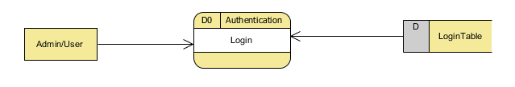
DATA FLOW DIAGRAM
A data flow diagram (DFD) is a graphical representation of the “flow” of data through an information system. It differs from the flowchart as it shows the data flow instead of the control flow of the program. A data flow diagram can also be used for the visualization of data processing. The DFD is designed to show how a system is divided into smaller portions and to highlight the flow of data between those parts.
Level 0

Slide 42
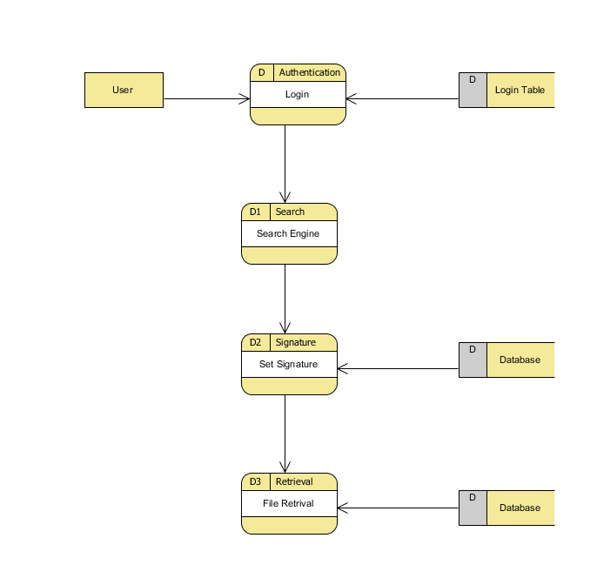
Level1

Slide 43
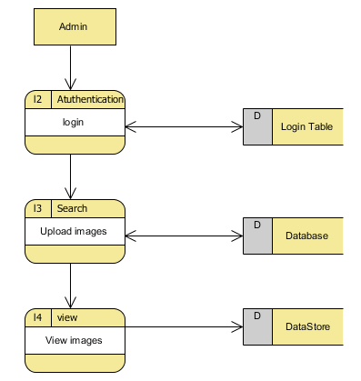
Level 2

Slide 44
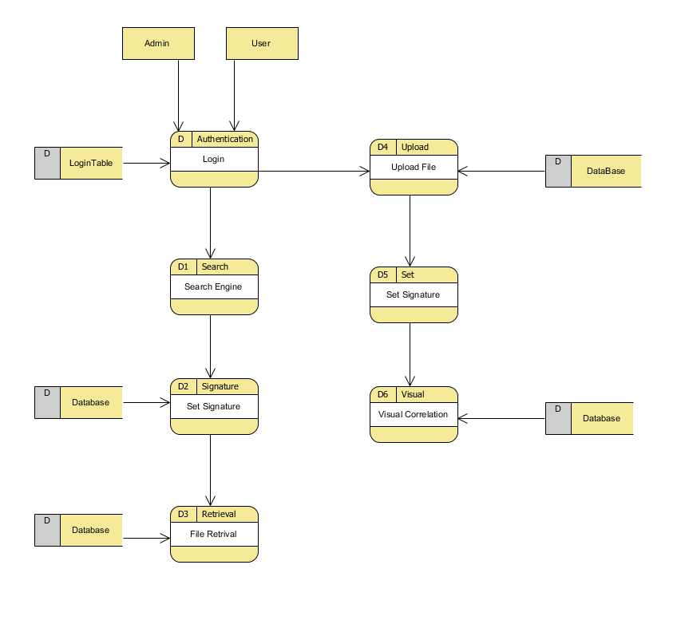
All Level DFD

Slide 45
E-R DIAGRAM:
In software engineering, an entity-relationship model (ERM) is an abstract and conceptual representation of data. Entity-relationship modeling is a database modeling method, used to produce a type of conceptual schema or semantic data model of a system, often a relational database, and its requirements in a top-down fashion. Diagrams created by this process are called entity-relationship diagrams, ER diagrams, or ERDs.

Slide 46
User id
Password
User
Type
Attributes
Images
Size
DB Contains
Image Upload
Attribute search
Images with description
Path
Content
Text-based Reranking
View images

Slide 47
SYSTEM ARCHITECTURE:
Architecture diagram shows the relationship between different components of system. This diagram is very important to understand the overall concept of system. Architecture diagram is a diagram of a system, in which the principal parts or functions are represented by blocks connected by lines that show the relationships of the blocks. They are heavily used in the engineering world in hardware design, electronic design, software design, and process flow diagrams.

Slide 48


o Admin
Admin
Image Upload
View Image
Database
SEARCH ENGINE
User
Attribute Image search
Attribute Augmented search

Slide 49
FUTURE ENHANCEMENT
In Future, We further extends the more suitable and appropriate image descriptions as per the images appear. In this module, collected augmented descriptions are all arrange in the basis of Tree structured semantic units. The units are all stored into the dataset in the structured format.
Module Diagram:
Tree structured Semantic unit
Dataset
Admin

Slide 50
GIVEN INPUT AND EXPECTED OUTPUT
STRUCTURED DATASET
Input: Choose the image
Output: Based upon image category Augmentation is stored.
ADVANTAGES
This method is more appropriate augmentation of image descriptions and this gives more useful accurate information about image.
APPLICATION
Image-Net.org URL: http://image-net.org/challenges/LSVRC/2014/
CONCLUSION
Structured image description method could jointly output the class, subclass and attributes for images, resulting in more informative structured image descriptions. Our method augmented structured SVM to solve the problem of image descriptions prediction. We propose a novel framework, which learns query-specific semantic spaces to significantly improve the effectiveness and efficiency of online image re-ranking

Slide 51
BIBILOGRAPHY
[1] L. Yang and A. Hanjalic, “Supervised reranking for web image search,” in Proc. Int. ACM Conf. Multimedia, 2010, pp. 183–192.
[2] X. Tian, L. Yang, J. Wang, Y. Yang, X. Wu, and X.-S. Hua, “Bayesian visual reranking,” Trans. Multimedia, vol. 13, no. 4, pp. 639–652, 2012.
[3] F. Schroff, A. Criminisi, and A. Zisserman, “Harvesting image databases from the web,” in Proc. IEEE Int. Conf. Comput. Vis., Oct. 2007, pp. 1–8.
[4] B. Siddiquie, R. S. Feris, and L. S. Davis, “Image ranking and retrieval based on multi-attribute queries,” in Proc. IEEE Conf. Comput. Vis. Pattern Recognit., Jun. 2011, pp. 801–808.
[5] A. Farhadi, I. Endres, D. Hoiem, and D. Forsyth, “Describing objects by their attributes,” in Proc. IEEE Conf. Comput. Vis. Pattern Recognit., Jun. 2009, pp. 1778–1785.

Slide 52
[6] N. Kumar, A. C. Berg, P. N. Belhumeur, and S. K. Nayar, “Attribute and simile classifiers for face verification,” in Proc. IEEE Int. Conf. Comput. Vis., Sep. /Oct. 2009, pp. 365–372.
[7] M. Wang, L. Yang, and X.-S. Hua, “MSRA-MM: Bridging research and industrial societies for multimedia,” Tech. Rep. MSR-TR-2009-30, 2009.
[8] K. Järvelin and J. Kekäläinen, “IR evaluation methods for retrieving highly relevant documents,” in Proc. ACM SIGIR Conf. Res. Develop. Inf. Retr., 2000, pp. 41–48.
[9] W. H. Hsu, L. S. Kennedy, and S.-F. Chang, “Video search reranking via information bottleneck principle,” in Proc. ACM Conf. Multimedia, 2006, pp. 35–44.
[10] Y. Huang, Q. Liu, S. Zhang, and D. N. Metaxas, “Image retrieval via probabilistic hypergraph ranking,” in Proc. IEEE Conf. Comput. Vis. Pattern Recognit., Jun. 2010, pp. 3376–3383.

